Slide 1
Development of a MoS₂/PEDOT:PSS Functionalized Electrode for Trace-Level Detection of Toxic Hg²⁺

Slide 2
What is MoS₂ & PEDOT:PSS ?
MoS₂ (molybdenum disulfide) is a two-dimensional transition metal dichalcogenide composed of layered S–Mo–S sheets, exhibiting semiconducting behavior, high surface area, and excellent electrocatalytic and electronic properties at the nanoscale.
Due to its large active surface, good charge carrier mobility, and strong interaction with analytes, MoS₂ is widely used in sensing, energy storage, and catalytic applications.
PEDOT:PSS is a conductive polymer composite consisting of poly(3,4-ethylenedioxythiophene) (PEDOT) as the conducting component and poly(styrene sulfonate) (PSS) as the charge-balancing and film-forming polyelectrolyte.
It exhibits high electrical conductivity, flexibility, optical transparency, and good film-forming ability, making it suitable for electrodes, biosensors, and flexible electronic devices.
The combination of MoS₂ and PEDOT:PSS provides synergistic advantages, including enhanced charge transfer, increased active surface area, and improved stability, which are highly beneficial for electrochemical sensing platforms.

Slide 3
Hydrothermal Method and polymerization
The hydrothermal method is a solution-based synthesis technique carried out in a sealed autoclave at elevated temperature and pressure, enabling controlled crystal growth of nanomaterials from aqueous precursors.
This method promotes high crystallinity, controlled morphology, and uniform particle size, making it widely used for preparing metal oxides, sulfides, and other functional nanostructures.
Chemical polymerization is a synthesis process in which monomer units are chemically oxidized to form long polymer chains, commonly used for preparing conducting polymers such as PEDOT.
In this method, an oxidizing agent initiates polymer chain formation, while dopants or polyelectrolytes (like PSS) improve conductivity, stability, and processability of the resulting polymer.
Both hydrothermal synthesis and chemical polymerization are important for developing advanced nanocomposites, as they allow control over structure, composition, and functional properties required for sensing and electronic applications.

Slide 4
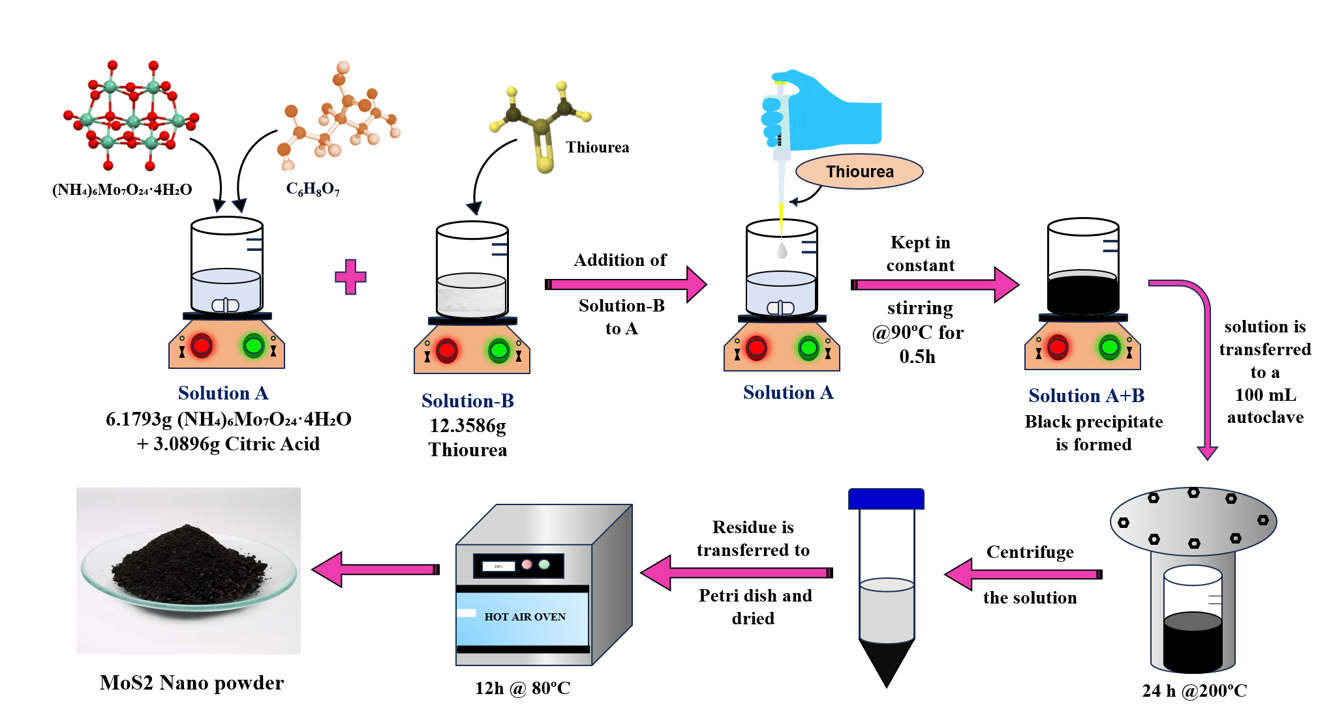
Synthesis of MoS₂ nanosheets

Slide 5
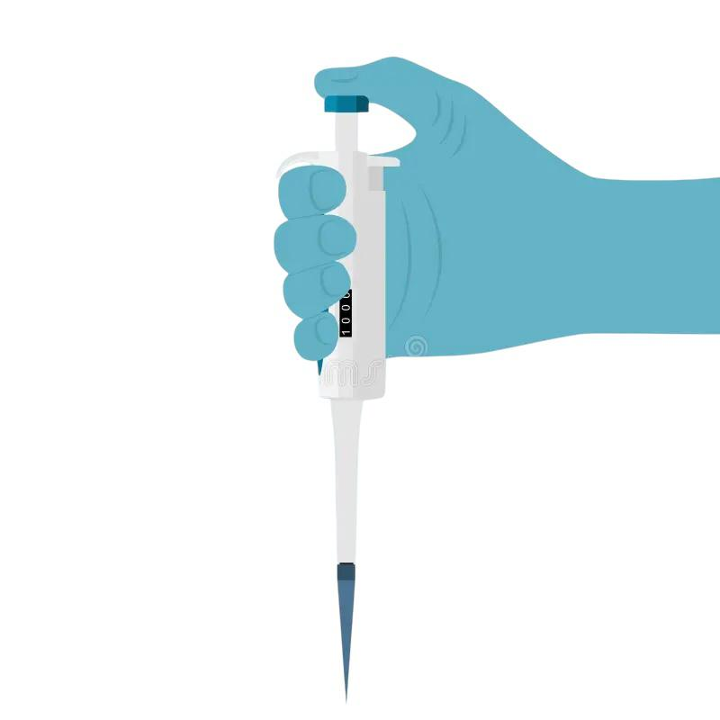
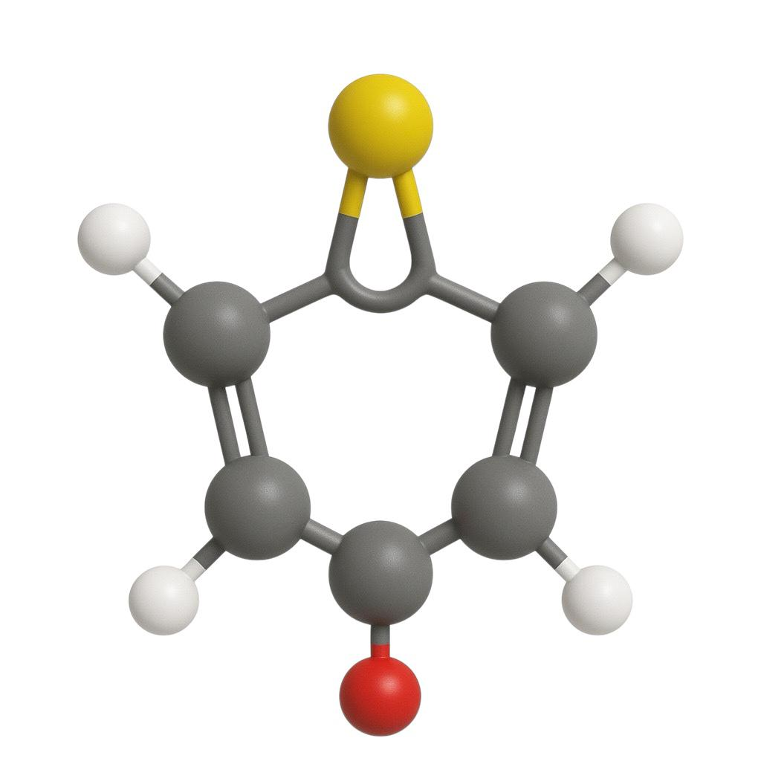
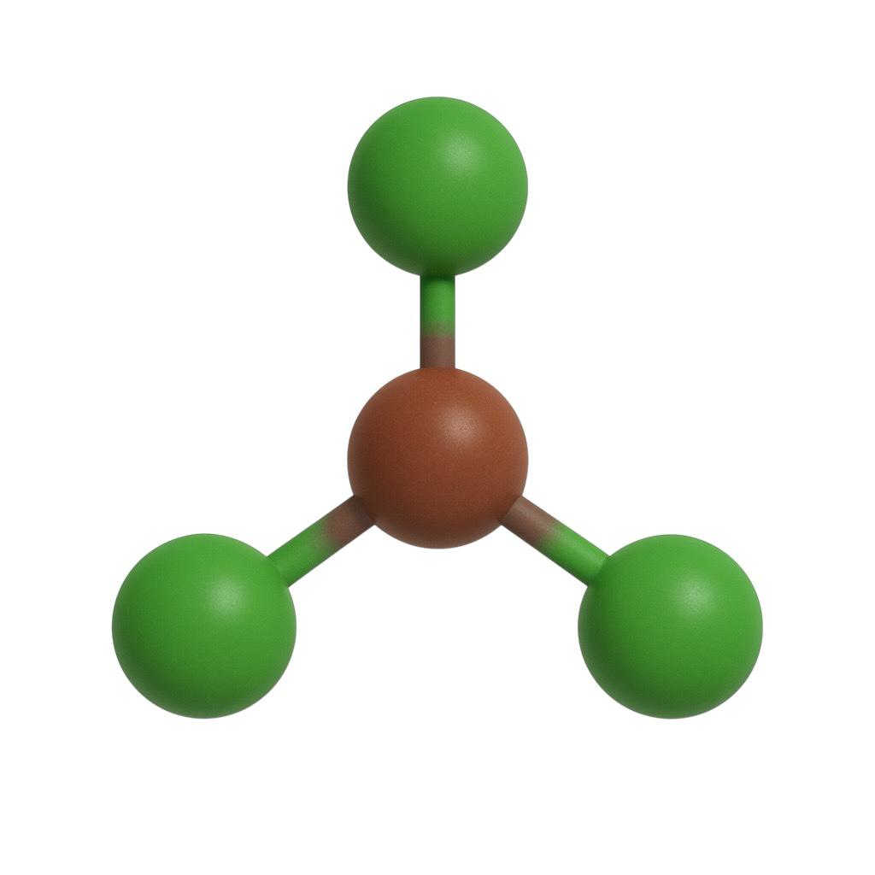
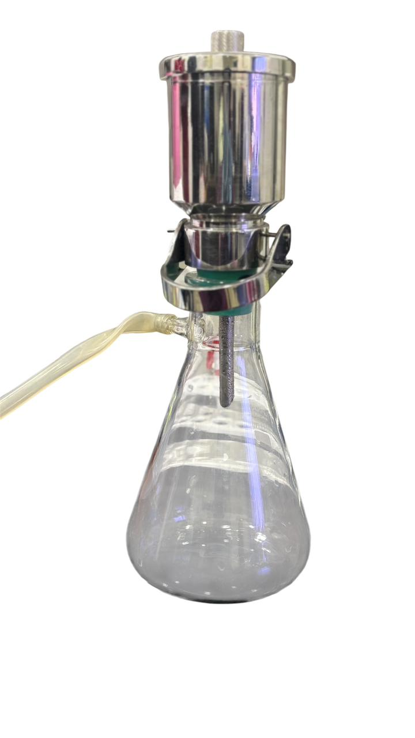
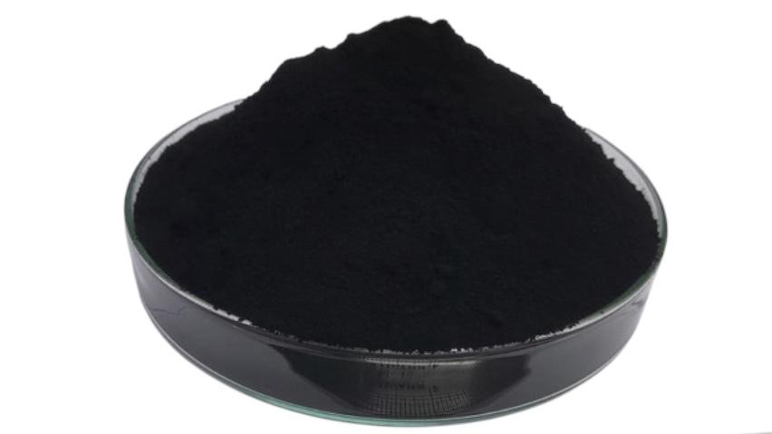
Synthesis of PEDOT-PSS
FeCl₃
Addition of solution B to solution A
Kept in constant stirring @90°C for 0.5h
Solution transferred to vacuum flask
Solution A
EDOT
Solution B
FeCl₃
Solution A
Solution A+B
Freeze dried
and stored
After grinding
_{PEDOT PSS Powder}

Slide 6
FE-SEM Analysis of PEDOT:PSS

Slide 8
FE-SEM Analysis of MoS₂

Slide 10
FE-SEM Analysis of PEDOT:PSS/MoS₂

Slide 12
FTIR SPECTRUM PEDOT:PSS/MoS₂

Slide 13
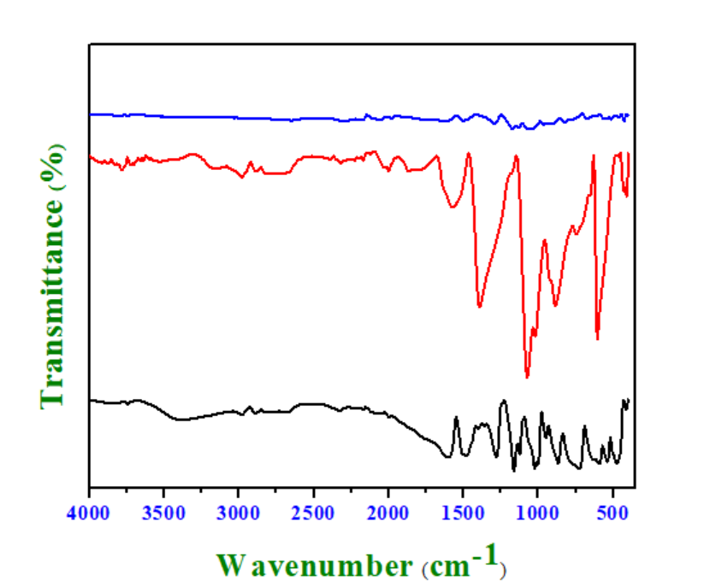
PEDOT-PSS/MoS₂
MoS₂
PEDOT-PSS

Slide 14
FTIR Spectral Analysis
The FTIR spectra display characteristic peaks of PEDOT:PSS and MoS₂, confirming the presence of both components in the composite material.
The PEDOT:PSS/MoS₂ spectrum shows combined vibrational features with slight shifts and intensity changes, indicating successful interaction and formation of the hybrid composite structure.
Peaks related to the thiophene ring vibrations and sulfonate groups of PEDOT:PSS are retained, demonstrating that the polymer backbone remains chemically stable after composite formation.
Characteristic Mo–S vibrational modes in the low wavenumber region confirm the structural integrity of MoS₂ within the composite.
The absence of new impurity peaks suggests good compatibility between PEDOT:PSS and MoS₂, supporting the formation of a well-integrated nanocomposite suitable for electronic and sensing applications.

Slide 15
X-Ray Diffractogram PEDOT:PSS/MoS₂

Slide 16
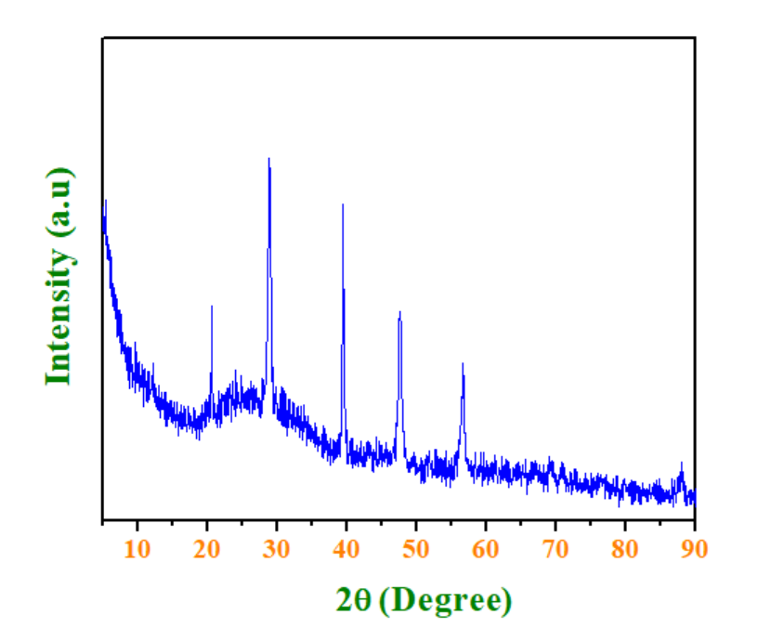
PEDOT-PSS/MoS₂

Slide 17
XRD Diffractogram Analysis
The XRD pattern of the PEDOT:PSS/MoS₂ composite shows characteristic diffraction peaks corresponding to crystalline MoS₂, confirming its structural retention within the hybrid material.
A broad background feature associated with PEDOT:PSS indicates the amorphous nature of the conducting polymer matrix.
The coexistence of sharp MoS₂ peaks and the broad polymer halo demonstrates successful incorporation of MoS₂ into the PEDOT:PSS framework without phase decomposition.
No additional impurity peaks are observed, suggesting good phase purity and compatibility between the inorganic MoS₂ and organic polymer components.
The composite structure supports enhanced interfacial interaction, which is beneficial for charge transport and electrochemical sensing performance.

Slide 18
Electrochemical sensing of Mercury (Hg²⁺)

Slide 19
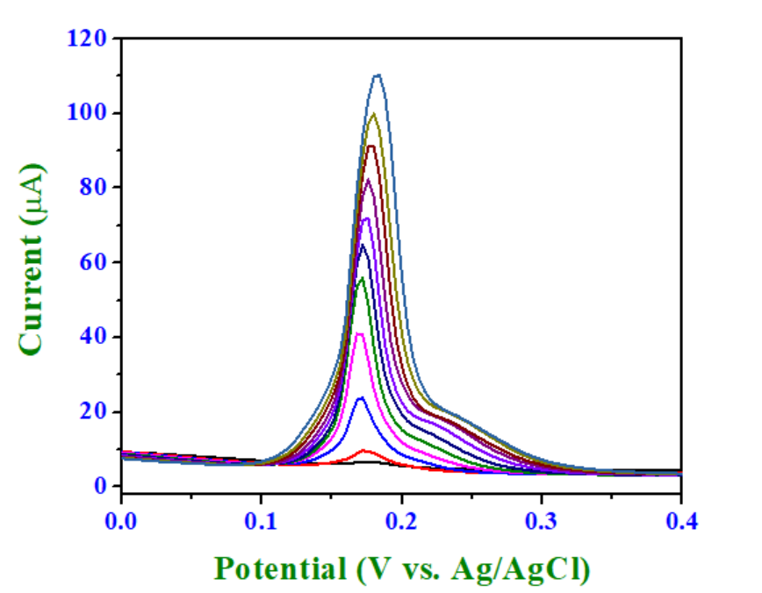
Method of standard addition
5µM
SWASV Voltammograms for the sensitive detection of Hg²⁺ ions using PEDOT:PSS/MoS₂ modified Glassy carbon electrode from 5µM to 55µM
Hg²⁺
55µM

Slide 20
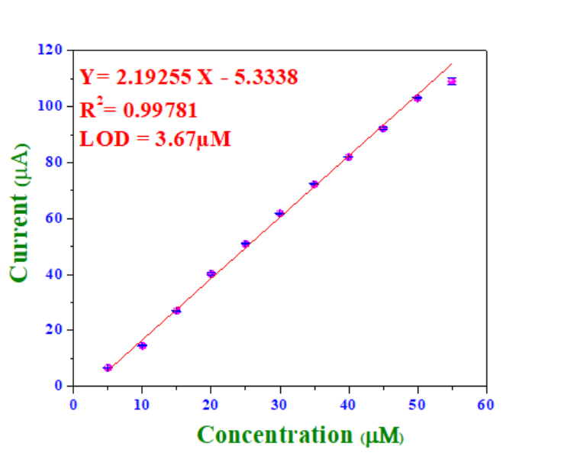
Linear range and Lod Calculation
The Calibration plot between the oxidation peak currents vs. the concentration of Mercury (Hg²⁺) (n = 3).
𝐿𝑂𝐷 = 3.3×Standard deviation/slope

Slide 21
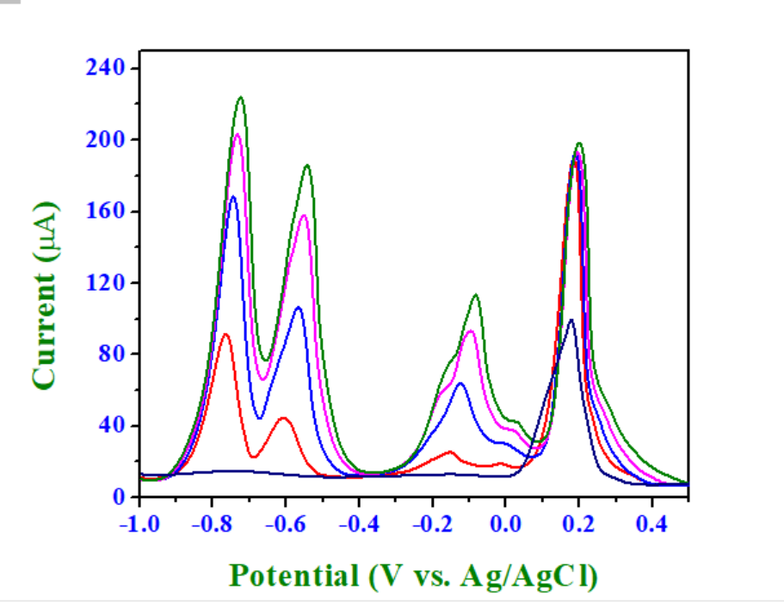
Interference effect of Other heavy metals
SWASV voltammograms illustrating the mutual interference analysis of heavy metal ions, demonstrating the sensor's capability to maintain distinct and well-defined anodic peaks with minimal cross-interference, even under varying analyte concentrations.
Cd²⁺
Hg²⁺
Pb²⁺
Cu²⁺

Slide 22
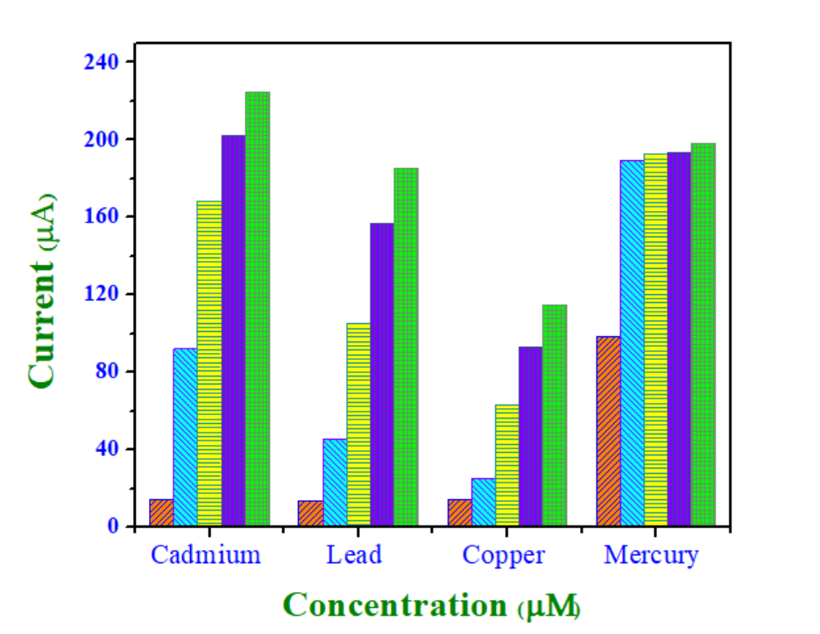
0 µM- 100µM
50µM
0 µM- 100µM
0 µM- 100µM

Slide 23
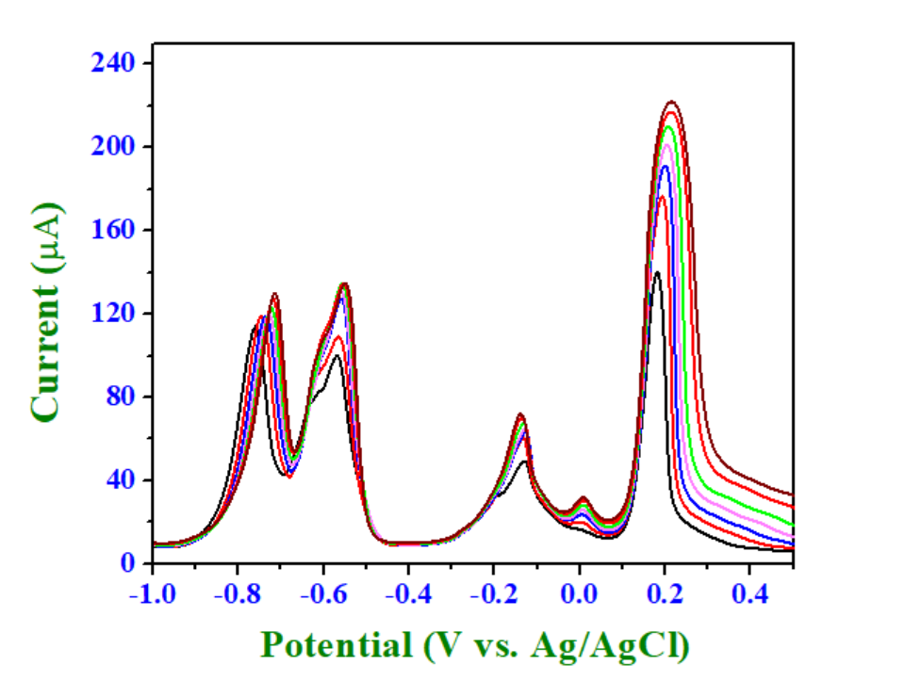
Hg²⁺
Cd²⁺
Pb²⁺
Cu²⁺

Slide 24
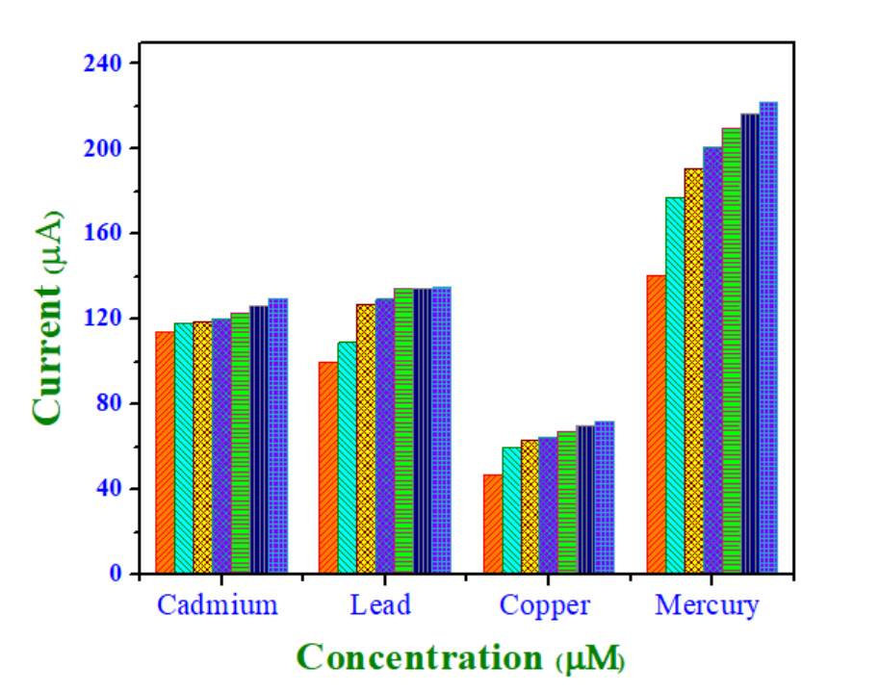
50- 200 µm
50 µM
50 µM
50 µM

Slide 25
THANK YOU

